Slide 1
Team Ink3D SRS Gate Review
Daniel Lain
Tim Edmonson
Shawn Simonson
Jesse Bowles

Slide 2
Overview
Product Concept
Functional Requirements
User Interface Requirements
Input and Output Requirements
Packaging Requirements
Performance Requirements
Other Requirements
Uses Cases
Feasibility Analysis

Slide 3
Product Concept
Product: 3-D Printer Fabrication System
Problem Solved: The need to fabricate custom human compatible medical devices
Audience:
Dr. Panos S. Shiakolas, Manufacturing Automation and Robotic Systems (MARS) lab at University of Texas Arlington,
Medical Researchers
Material Researchers

Slide 4
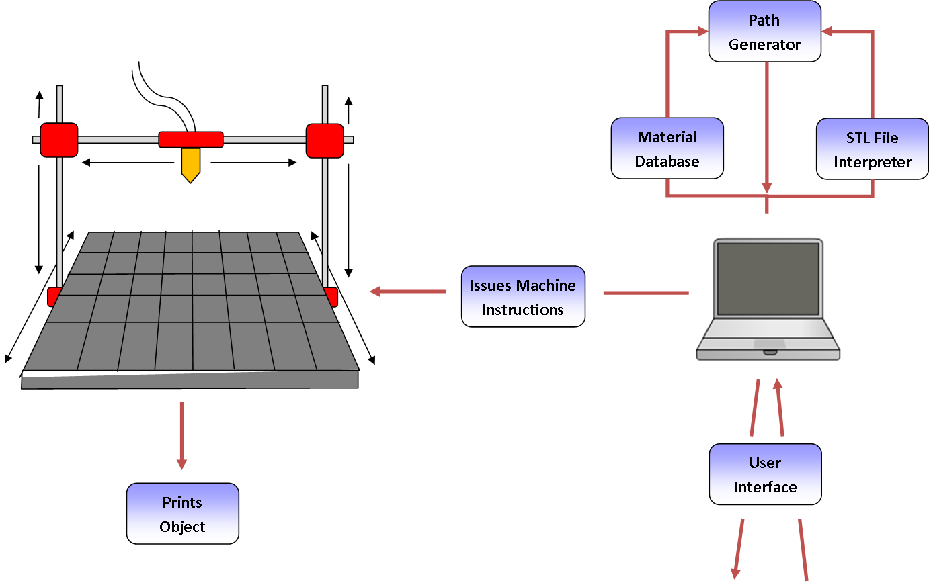
Product Concept

Slide 5
Functional Requirements
3.1 STL File Input
3.1.1 Description: The system shall provide a way for the user to select an STL file and then input that STL file into the system for processing.
3.1.2 Source: Dr. Panos S. Shiakolas (Sponsor)
3.1.3 Constraints: The system must support multi-material objects but the STL file format does not support material information.
3.1.4 Standards: STL (STereo Lithography) File Format
3.1.5 Priority: 1 – Critical
3.4 Issue Machine Instructions
3.4.1 Description: The system shall issue generated machine instructions from the software component to the printing hardware component.
3.4.2 Source: Dr. Panos S. Shiakolas (Sponsor)
3.4.3 Constraints: None
3.4.4 Standards: GCode
3.4.5 Priority: 1 – Critical

Slide 6
Functional Requirements
3.5 Monitor Temperature
3.5.1 Description: The system shall monitor input from heat sensors attached to the printing hardware. The temperature of each extruder’s nozzle must be monitored at all times to ensure that material is extruded at the proper temperature.
3.5.2 Source: Dr. Panos S. Shiakolas (Sponsor)
3.5.3 Constraints: In order to monitor the temperature of different extruder nozzles, the printing hardware must output information describing the temperature of each extruder nozzle.
3.5.4 Standards: None
3.5.5 Priority: 1 – Critical
3.6 Monitor Position
3.6.1 Description: The system shall monitor the position of the printing head at all times during operation. The system must be aware of the position of the printing head in order to adhere to a predefined printing path.
3.6.2 Source: Dr. Panos S. Shiakolas (Sponsor)
3.6.3 Constraints: In order for the printing head position to be monitored by the system, the printing hardware must output information describing the position of the printing head.
3.6.4 Standards: None
3.6.5 Priority: 1 – Critical

Slide 7
Functional Requirements
3.8 Identify Materials
3.8.1 Description: The system shall identify every type of material that is being used for printing the 3D object.
3.8.2 Source: Dr. Panos S. Shiakolas (Sponsor)
3.8.3 Constraints: None
3.8.4 Standards: STL
3.8.5 Priority: 1 - Critical
3.9 Identify Shapes
3.9.1 Description: The system shall identify the shape of the object being printed by dividing it into smaller shapes for each individual material used.
3.9.2 Source: Dr. Panos S. Shiakolas (Sponsor)
3.9.3 Constraints: Unification of multiple shapes within the same dimensional space.
3.9.4 Standards: STL file
3.9.5 Priority: 1 - Critical

Slide 8
Functional Requirements
3.10 Determine Shape of Support Material Structure
3.10.1 Description: The system shall determine the shape that the support material needs to be for stabilizing the 3D object as it is being printed. Without the support, the object could collapse during printing.
3.10.2 Source: Dr. Panos S. Shiakolas (Sponsor)
3.10.3 Constraints: Complex analytical geometry.
3.10.4 Standards: None
3.10.5 Priority: 1 - Critical
3.11 Create Printing Path
3.11.1 Description: The system shall determine a route that the printing head must follow as it prints.
3.11.2 Source: Dr. Panos S. Shiakolas (Sponsor)
3.11.3 Constraints: Cannot print two materials on the same path.
3.11.4 Standards: G-Code
3.11.5 Priority: 1 - Critical

Slide 9
Functional Requirements
3.14 Slice Geometry into Thickness Levels
3.14.1 Description: The system shall be able to process geometry in such a way as to generate sub-models of appropriate and customizable thickness such that the 3D printer can print each layer of the given thickness.
3.14.2 Source: Dr. Panos S. Shiakolas (Sponsor)
3.14.3 Constraints: None
3.14.4 Standards: None
3.14.5 Priority: 1 – Critical
3.17 Allow for UV Head Polymerization
3.17.1 Description: The head shall be able to use UV light to cure or dry the extruded material. The system shall accommodate the use of UV to be turned on and off such that the material can be cured.
3.17.2 Source: Dr. Panos S. Shiakolas (Sponsor)
3.17.3 Constraints: The system shall allow for duplicate paths.
3.17.4 Standards: None
3.17.5 Priority: 1 – Critical

Slide 10
Functional Requirements
Non Critical Requirements
3.16 Monitor Door Switch
3.18 Sparsity and Density Controls

Slide 11
User Interfaces Requirements
3.2 Graphical User Interface
3.2.1 Description: The system shall provide a graphical user interface from which the user can import 3D models and initiate print operations. The GUI must be both intuitive and responsive.
3.2.2 Source: Dr. Panos S. Shiakolas (Sponsor)
3.2.3 Constraints: None
3.2.4 Standards: Java Swing/AWT
3.2.5 Priority: 3 – Moderate
3.12 Database Interface
3.12.1 Description: The system shall have an interface that allows the user to view what material is already stored in the database and enter new information for material not already stored.
3.12.2 Source: Dr. Panos S. Shiakolas (Sponsor)
3.12.3 Constraints: None
3.12.4 Standards: Java / Swing / AWT
3.12.5 Priority: 1 - Critical

Slide 12
User Interfaces Requirements
3.13 Store & Load Material Records
3.13.1 Description: The system shall be able to load the material records stored in the materials database in order to control the temperature, movement speed, and flow speed of the nozzle at the correct setting.
3.13.2 Source: Dr. Panos S. Shiakolas (Sponsor)
3.13.3 Constraints: None
3.13.4 Standards: Must be able to be serialized.
3.13.5 Priority: 1 – Critical
3.19 Graphical Object Models
3.19.1 Description: The system shall display a graphical model of the objects represented by imported STL files. The user will be able to drag the graphical model around on a virtual printer bed in order to specify the location on the printer bed where the object will be printed.
3.19.2 Source: Dr. Panos S. Shiakolas (Sponsor)
3.19.3 Constraints: This will require graphics processing and may make the GUI unresponsive.
3.19.4 Standards: None
3.19.5 Priority: 5 – Future

Slide 13
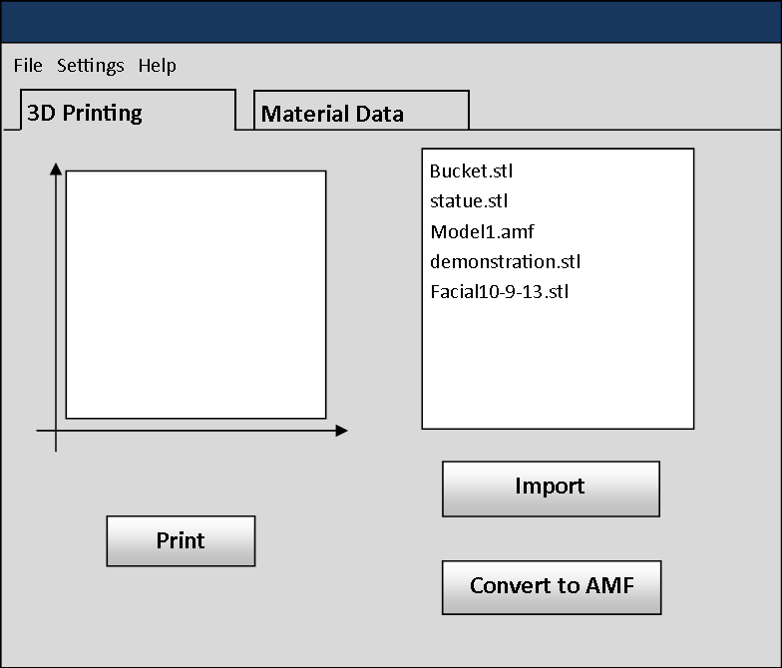
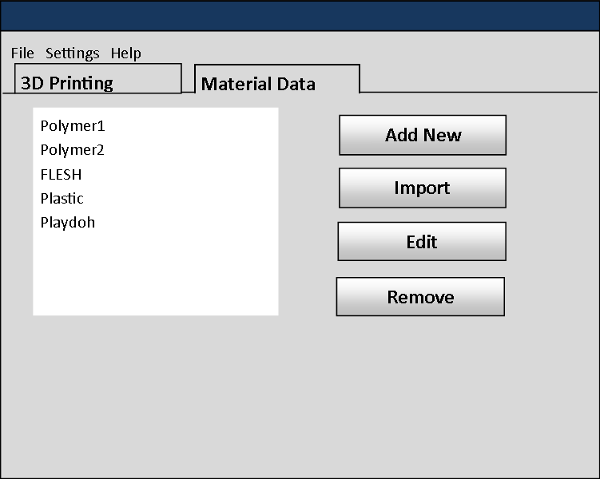
User Interface

Slide 14
Inputs and Outputs
Inputs
STL File
Material Data
GUI Selection
Start Printing
Stop/Pause Printing
Heat Sensor
Position Sensor
Flow Sensor
Door Sensor
Outputs
G-Codes
State Notification
Confirmation Message(s)
Printed Object

Slide 15
Packaging Requirements
4.1 Software Installer
4.1.1 Description: The host software shall be delivered as an executable installer via USB flash memory and Compact Disc.
4.1.2 Source: Dan Lain (Team Member)
4.1.3 Constraints: None
4.1.4 Standards: Windows Installer
4.1.5 Priority: 1 – Critical
4.2 Host Software to Printer Connection
4.2.1 Description: The host software shall be connected to the printing hardware using a DE-9, DB-25, or Universal Serial Bus cable.
4.2.2 Source: Shawn Simonson (Team Member)
4.2.3 Constraints: None
4.2.4 Standards: USB, RS-232
4.2.5 Priority: 1 – Critical

Slide 16
Packaging Requirements
4.3 User Manual
4.3.1 Description: The system shall be delivered with a user manual. The user manual will include detailed instructions on how to operate the host software and how to properly connect the host software to the printer.
4.3.2 Source: Tim Edmondson (Team Member)
4.3.3 Constraints: None
4.3.4 Standards: None
4.3.5 Priority: 3 - Moderate

Slide 17
Performance Requirements
5.1 Startup Time
5.1.1 Description: The host software shall start in one minute or less.
5.1.2 Source: Tim Edmondson (Team Member)
5.1.3 Constraints: None
5.1.4 Standards: None
5.1.5 Priority: 4 – Low
5.2 STL Import Time
5.2.1 Description: The host software shall import STL files in one minute or less.
5.2.2 Source: Tim Edmondson (Team Member)
5.2.3 Constraints: None
5.2.4 Standards: The STL file format will be imported.
5.2.5 Priority: 4 – Low

Slide 18
Performance Requirements
5.3 Object Processing Time
5.3.1 Description: The host software shall perform object processing and machine instruction generation in five minute or less.
5.3.2 Source: Tim Edmondson (Team Member)
5.3.3 Constraints: The geometric processing algorithms used to process objects must be efficient.
5.3.4 Standards: None
5.3.5 Priority: 2 – High
5.4 GUI Responsiveness
5.4.1 Description: The graphical components of the user interface shall be responsive to user interaction.
5.4.2 Source: Tim Edmondson (Team Member)
5.4.3 Constraints: In order to achieve a responsive user interface, multi-thread processing may be required.
5.4.4 Standards: None
5.4.5 Priority: 3 – Moderate

Slide 19
Performance Requirements
5.5 Real Time Sensor Monitoring
5.5.1 Description: The system shall monitor data from sensors in real time during operation. The sensor data must be monitored in real time to ensure proper printer functionality as well as enforce safety systems.
5.5.2 Source: Tim Edmondson (Team Member)
5.5.3 Constraints: Constant monitoring of sensors could require expensive processing and memory resources.
5.5.4 Standards: None
5.5.5 Priority: 2 – High

Slide 20
Other Requirements : Safety
6.1 Temperature Cutoff Threshold
6.1.1 Description: The system shall include a temperature cutoff threshold for the printer head. If the temperature of the printer head reaches the cutoff temperature, the system will abort the operation and shut off the heating device.
6.1.2 Source: Tim Edmondson (Team Member)
6.1.3 Constraints: The system must be able to accurately monitor the temperature of each printing head.
6.1.4 Standards: None
6.1.5 Priority: 1 – Critical
6.2 Printing Area Restrictions
6.2.1 Description: The system shall only extrude material within a configured area. Material extruded by the printer will be at a high temperature and may cause harm to the printer’s surroundings; therefore it is important to ensure that the material is only extruded in a specified safe area.
6.2.2 Source: Tim Edmondson (Team Member)
6.2.3 Constraints: None
6.2.4 Standards: None
6.2.5 Priority: 1 – Critical

Slide 21
Other Requirements: Maintenance and Support
7.1 Host Software Manual
7.1.1 Description: A manual that details the operation of the host software shall be provided. Here, “host software” is that software which is run on the workstation that generates machine instructions for the printing hardware. The manual must detail common troubleshooting issues as well as provide basic usage instructions.
7.1.2 Source: Shawn Simonson (Team Member)
7.1.3 Constraints: None
7.1.4 Standards: None
7.1.5 Priority: 1 – Critical
7.2 Source Code Documentation
7.2.1 Description: The source code developed by the software team shall be well documented with comments explaining the functionality of all modules and any non- obvious code. This documentation is intended to support any future development on the system.
7.2.2 Source: Tim Edmondson (Team Member)
7.2.3 Constraints: None
7.2.4 Standards: None
7.2.5 Priority: 2 – High

Slide 22
Other Requirements: Maintenance and Support
7.3 Source Code Availability
7.3.1 Description: The source code developed by the software team shall be freely available to developers and the public. The source code will be hosted on a public repository.
7.3.2 Source: Shawn Simonson (Team Members)
7.3.3 Constraints: None
7.3.4 Standards: Git, SVN
7.3.5 Priority: 2 – High

Slide 23
Other Requirements: Additional
8.1 Material Database
8.1.1 Description: The system shall have a database that holds information about how the material is printed. For each material, the database must hold the diameter of the material filament and the temperature the filament must be extruded at.
8.1.2 Source: Dr. Panos S. Shiakolas (Sponsor)
8.1.3 Constraints: None
8.1.4 Standards: Binary Text
8.1.5 Priority: 1 – Critical
8.2 Abstract Hardware Interface
8.2.1 Description: The system shall allow for multiple different printers and multiple different heads to be used with minimal software change.
8.2.2 Source: Jesse Bowles (Team Member)
8.2.3 Constraints: Unknown hardware interface
8.2.4 Standards: None
8.2.5 Priority: 1 – Critical

Slide 24
Other Requirements: Additional
8.3 Modular and Scalable Design
8.3.1 Description: The software shall be developed using proven design principles to ensure that it can be scaled and maintained by future development teams.
8.3.2 Source: Dr. Panos S. Shiakolas (Sponsor)
8.3.3 Constraints: None
8.3.4 Standards: S.O.L.I.D. Design Principles
8.3.5 Priority: 1 – Critical

Slide 25
Other Requirements: Acceptance Criteria
9.1 Verify that the system reads STL files
9.1.1 Requirement(s) addressed:
3.1 – STL File Input
9.1.2 Verification Procedure: The user will be able to see the file has been accepted and the file name will be displayed in the GUI.
9.2 Verify the database interface
9.2.1 Requirement(s) addressed:
3.2 – Graphical User Interface
3.13 – Database Interface
3.14 – Store and Load Material Records
8.1 – Material Database
9.2.2 Verification Procedure: The user will load the GUI and click on the view/edit database button. The user then will see and be able to edit stored values. Upon changing values the user will return to the main menu. Clicking on the view/edit button again will display the edited values.

Slide 26
Other Requirements: Acceptance Criteria
9.3 Verify the system prints a model
9.3.1 Requirement(s) addressed:
3.1 – STL File Input 3.3 – Generate Machine Instructions
3.4 – Issue Machine Instructions 3.6 – Monitor Temperature
3.7 – Monitor Position 3.8 – Identify Material Constraints
3.9 – Identify Materials 3.10 – Identify Shapes
3.11 – Determine Shape of Support Material Structure 3.12 – Create Printing Path
3.14 – Store and Load Material Records 3.15 – Slice Geometry into Thickness Levels
3.16 – Monitor Flow Sensors 4.2 – Host Software to Printer Connection
9.3.2 Verification Procedure: The user will load an STL file and click print. The system will then print the correct shape and material.
9.4 Verify the system stops printing of out of operational range
9.4.1 Requirement(s) addressed:
6.1 – Temperature cutoff threshold 3.16 – Monitor Flow Sensors
9.4.2 Verification Procedure: During a print run a fan will be pointed at the head reducing its temperature to below specified material requirements and the printer will stop printing until the temperature is raised to the correct level.

Slide 27
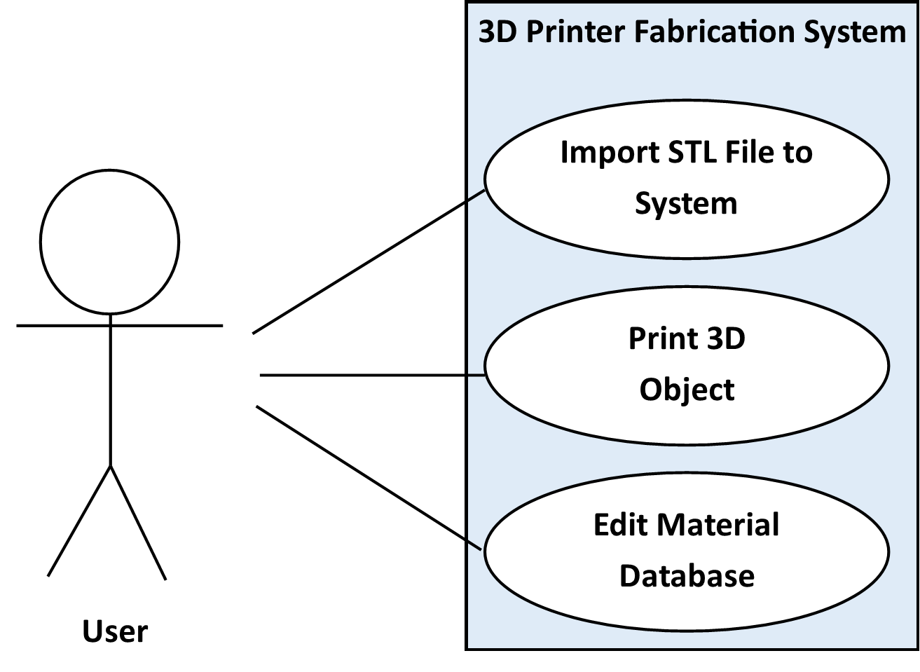
Use Case Diagram

Slide 28
Use Cases
10.1 Import STL File to System
10.1.1 Scenario: The user selects an STL file to be printed.
10.1.2 Actor(s): The user
10.1.3 TUCBW: The user clicks the “Import STL” button
10.1.4 TUCEW: The user sees the confirmation message that STL file was successfully uploaded.
10.2 Print 3D Object
10.2.1 Scenario: The user uses the system to print an STL file as a physical 3D object.
10.2.2 Actor(s): The user
10.2.3 TUCBW: The user clicks the print button.
10.2.4 TUCEW: The user sees the physical 3D object on the platform.
10.3 Edit Material Database
10.3.1 Scenario: The user can add new or modify material information in the database.
10.3.2 Actor(s): The user
10.3.3 TUCBW: The user clicks the “Update Materials” button.
10.3.4 TUCEW: The user sees the material updated in the database.

Slide 29
Feasibility: Scope Analysis
Scope: Software only
Majority of the scope:
Customer Requirement 3.14 Slicing Geometry into Thickness Levels
Customer Requirement 3.11 Creating Printing Paths
Customer Requirement 3.3 Generating Machine Instructions
Customer Requirement 3.4 Issuing Machine Instructions

Slide 30
Feasibility: Key Risks and Deficiencies
STL format not sufficient for describing multiple materials
Resolution: Simple conversion to another format (AMF)
Slic3r is unsuited for the task as-is
Deficiency: Analytic Geometry skills not sufficient
Resolution: Research and Experimentation
Hardware implementation problems
Deficiency: Only one computer engineer with sufficient hardware knowledge/experience
Resolution: Scope Definition
Lack of 3-D printing experience
Resolution: Research and Demonstrations

Slide 31
Feasibility: Cost Analysis
 | Quantity | Cost/Unit | Total Cost
SainSmart Mega2560 Controller | 1 | 43.17 | 43.17
SainSmart RAMPS 1.4 Shield | 1 | 25.9 | 25.9
SainSmart A4988 Driver | 7 | 10.97 | 76.79
Raspberry Pi Model B R2.0 | 1 | 39.95 | 39.95
8GB SD Flash Card | 1 | 9.88 | 9.88
Male/Male USB 2.0 Cable | 1 | 9.95 | 9.95
50ft. 20GA Solid Copper Interconnect | 1 | 15.95 | 15.95
SainSmart 1602 LCD Shield | 1 | 24.95 | 24.95
Passive Electronics Budget | 1 | 25 | 25
Total |  |  | 271.54

Slide 32
Feasibility: Size – Function Points
Function Points Analysis
Program Characteristic | Low Complexity | Moderate Complexity | High Complexity | Function Point Totals
Number of Inputs | 12*3 | 1*4 | 2*6 | 52
Number of Outputs | 2*4 | 0*5 | 4*7 | 36
Inquiries | 2*3 | 0*4 | 2*6 | 18
Logical Internal Files | 1*7 | 0*10 | 2*15 | 37
External Interface File | 0*5 | 0*7 | 1*10 | 10
Unadjusted Function Points |  |  |  | 153
Adjustment Factor |  |  |  | .99
Adjusted Function Point Total |  |  |  | 152

Slide 33
Feasibility: Size – Lines of Code
Size Estimate – Lines of Code
 | Low Side Estimation | High Side Estimation
Size Estimate | 6,000 Lines of Code | 10,000 Lines of Code
Productivity | 300 Lines of Code | 250 Lines of Code
Effort | 20 Months | 40
Duration of 4 Person Team | 5 Months | 10 months

Slide 34
Feasibility: Effort
Jones First Order Estimation
Worst in Class | Average in Class | Best in Class
152^{.48} | 152^{.45} | 152^{.43}
11.2 Calendar Months | 9.6 Calendar Months | 8.7 Calendar Months
CoCoMo Estimate
 | Low Estimate | High Estimate
Effort – Person Months | E = 3.0(5)^{1.12} E= 18.2 Man Months | E = 3.0(10)^{1.12} E= 39.5 Man Months
Duration – Months | D = 2.5(18.3)^{.35} D = 7 Months | D = 2.5(18.3)^{.35} D = 9 Months
Estimate Comparison
Method | Low Estimate | High Estimate
Jones First Order | 8 Months | 11 Months
Lines of Code | 5 Months | 10 Months
CoCoMo | 7 Months | 9 Months
Average | 6.6 Months | 10 Months

Slide 35
Feasibility: Conclusion
Project is Feasible

